Slide 1
Impacts of Bioinformatics

Slide 2
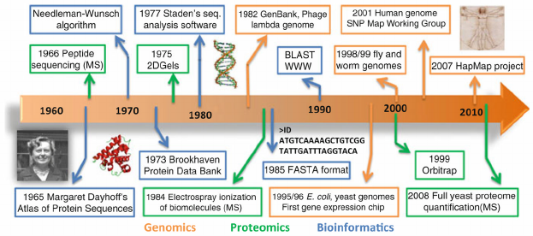
Landmarks in Bioinformatics
Source: Comparative Interaction Networks: Bridging Genotype to Phenotype
Adv Exp Med Biol. 2012 ; 751: 139–156. doi:10.1007/978-1-4614-3567-9_7

Slide 3
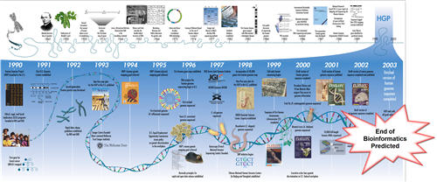
Bioinformatics here to stay?
Lincoln Stein's prediction, Feb 2003_ Bioinformatics: Gone in 2012
In 2008 he published a correction: Bioinformatics: alive and kicking
Genome Biology 2008, 9:114 (doi:10.1186/gb-2008-9-12-114)

Slide 4
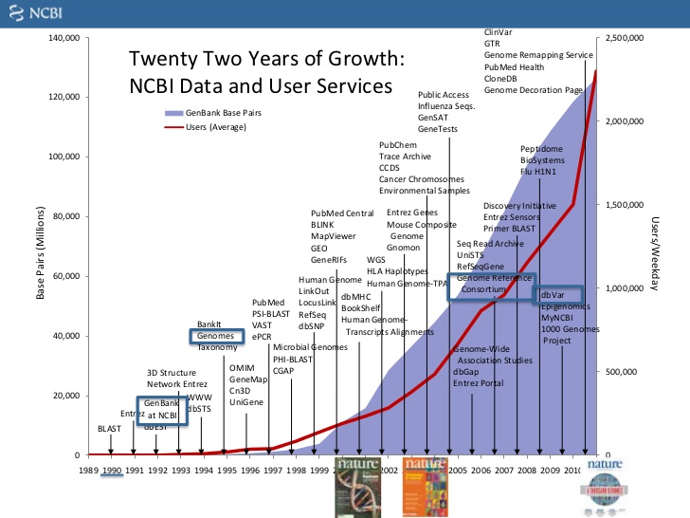
Growth of sequence data and users

Slide 5
Socially, what drives the process?
Some of the priority areas of investment that have triggered developments in Bioinformatics
1985 Biotechnology
2000 Personalised Medicine, Genomes & Health.
2010 Environmental Issues. GMOs & Food controls.
2015 Precision Medicine & Systems Biology
2020 … Immunotherapy. Ecosystem (remediation?)

Slide 6
Where is Bioinformatics heading?
Coping with the Omic information deluge and growing service needs is a big challenge in itself
But it is relatively small compared with what we anticipate will come in what concerns the need to
better interpret research data (recognise conserved domain architectures, use systems level reasoning in Biology and Medicine)
make more accurate predictions (inference)
understand complex genetic traits in health and disease

Slide 7
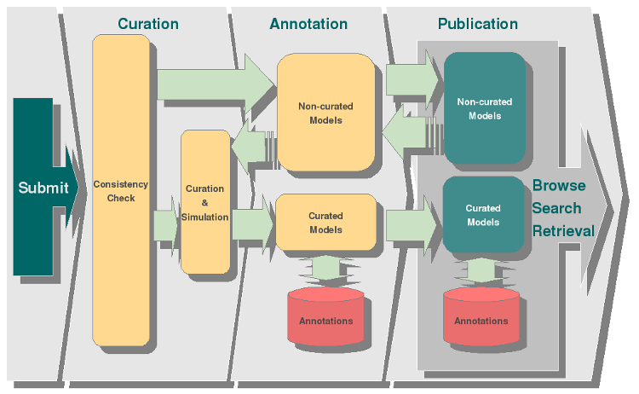
From data to curated models
Curation and annotation pipeline in the BioModels Database
Source: European Bioinformatics Institute
http://www.ebi.ac.uk/biomodels-main/develop

Slide 8
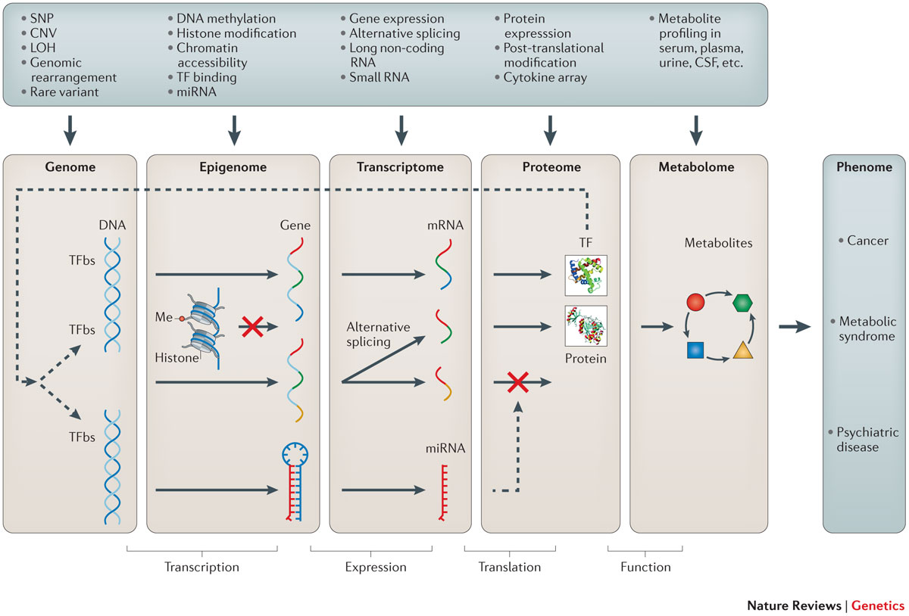
Gains in knowledge via integration
Source: Methods of integrating data to uncover genotype–phenotype interactions
Marylyn D. Ritchie, Emily R. Holzinger, Ruowang Li, Sarah A. Pendergrass & Dokyoon Kim
Nature Reviews Genetics 16, 85–97 (2015) doi:10.1038/nrg3868

Slide 9
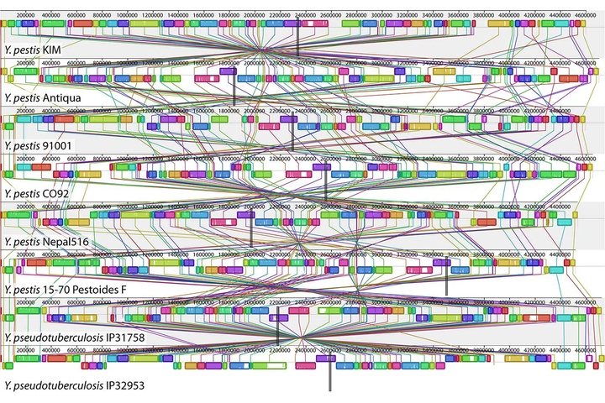
Understanding to fight disease
A genome alignment of eight Yersinia isolates.
(source: PLOS Genetics on Wikimedia Commons).
Deep learning meets genome biology
An interview with Brendan Frey about realizing new possibilities in genomic medicine.
https://www.oreilly.com/ideas/deep-learning-meets-genome-biology

Slide 10
Using large datasets
Using large datasets together with powerful analytics and machine learning allows for generating and testing hypotheses in unprecedented ways
It does require specific skills but the most serious bottleneck is still.. human!

Slide 11
The human resource issues
Education
The need for Bioinformatics-aware biomedical professionals is horizontal.
Training
Bioinformatics tools and data resources evolve rapidly and their correct usage requires skills.

